Slide 1
Life science in Hagastaden
Uppdated: 2024-09-06
Questions? info@ssci.se

Slide 2
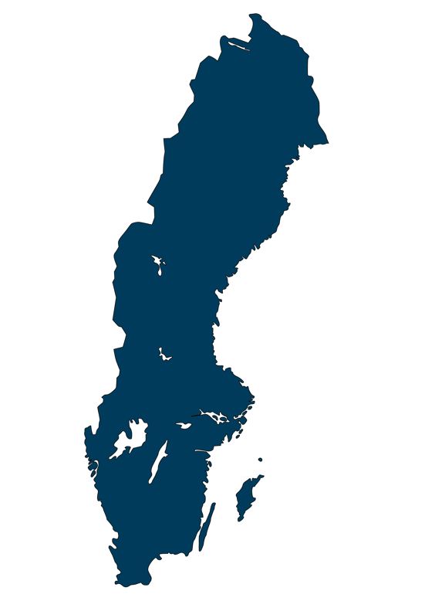
Life science industry in Sweden
7% Unknown size (229)
9%
Others (326)
A total of
4000
54%
East (2178)
16%
West (627)
life science companies in Sweden
21%
South (829)
Source: Vinnova Statistik över svenska life science-företag, Appendix 5. Uppdaterad statistik inom N2021/02243,
October 2023 / STUNS Insight Machine. Refers to 2021.
*A majority of the companies are reported to be active in medical technology, but the overlap of segments is significant, meaning that the sum of the reported numbers is greater than 4000. The segmentation shown here was reported
by Vinnova and is based on an automated algorithm.

Slide 3


The life science industry in Stockholm
Company size Empolyees
One-person companies* 0
Micro companies 1-9
Small companies 10-49
Medium-sized companies 50-249
Large companies >250
Stockholm
A total of
1733
life science companies in Stockholm
Source: STUNS Insight Machine, regional processing by Stockholm Science City.
Refer to companies in Stockholm County, 2022.
*One-person companies are companies without employees. These can include newly established firms
that have yet to hire staff, or businesses where the owner invoices clients instead of drawing a salary.
This category also covers companies that have not reported any employees.
Notes:
Stockholms län

Slide 4
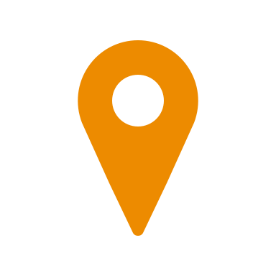
The life science industry in Hagastaden
Company size Employees
One-person companies 0
Micro companies 1-9
Small companies 10-49
Medium-sized companies 50-249
Large companies >250
161
A total of
life science companies in Hagastaden
Source: STUNS Insight Machine, regional processing by Stockholm Science City.
Refer to companies in Stockholm County, 2022.
*One-person companies are companies without employees. These can include newly established firms
that have yet to hire staff, or businesses where the owner invoices clients instead of drawing a salary.
This category also covers companies that have not reported any employees.

Slide 5
Life science industry in Hagastaden
Number of employees
Company size Employees
Micro companies 1-9
Small companies 10-49
Medium-sized companies 50-249
Large companies >250
2188
A total of
Employees in life science companies in Hagastaden
Source: STUNS Insight Machine, regional processing by Stockholm Science City.
Refer to companies in Stockholm County, 2022.
Notes:
Diagnostik oftast inte huvudkategorin

Slide 6
Life science industry in Hagastaden
Total revenue*
Company size Employees
One-person companies 0
Micro companies 1-9
Small companies 10-49
Medium-sized companies 50-249
Large companies >250
11,5bn
A total of
*The revenue numbers exklude
Swedish Orphan Biovitrum AB (SOBI). Total revenue incl. SOBI is SEK 25 billion
Revenue in life science companies in Hagastaden
Source: STUNS Insight Machine, regional processing by Stockholm Science City.
Refer to companies in Stockholm County, 2022.
*One-person companies are companies without employees. These can include newly established firms
that have yet to hire staff, or businesses where the owner invoices clients instead of drawing a salary.
This category also covers companies that have not reported any employees.

Slide 7

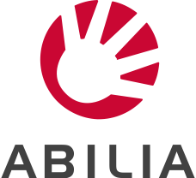





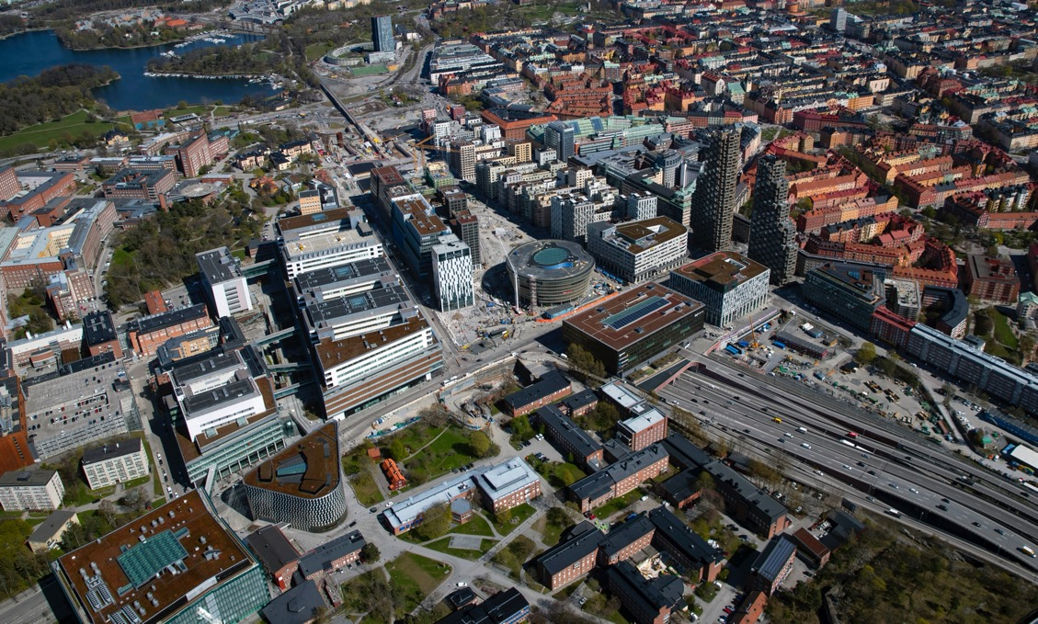
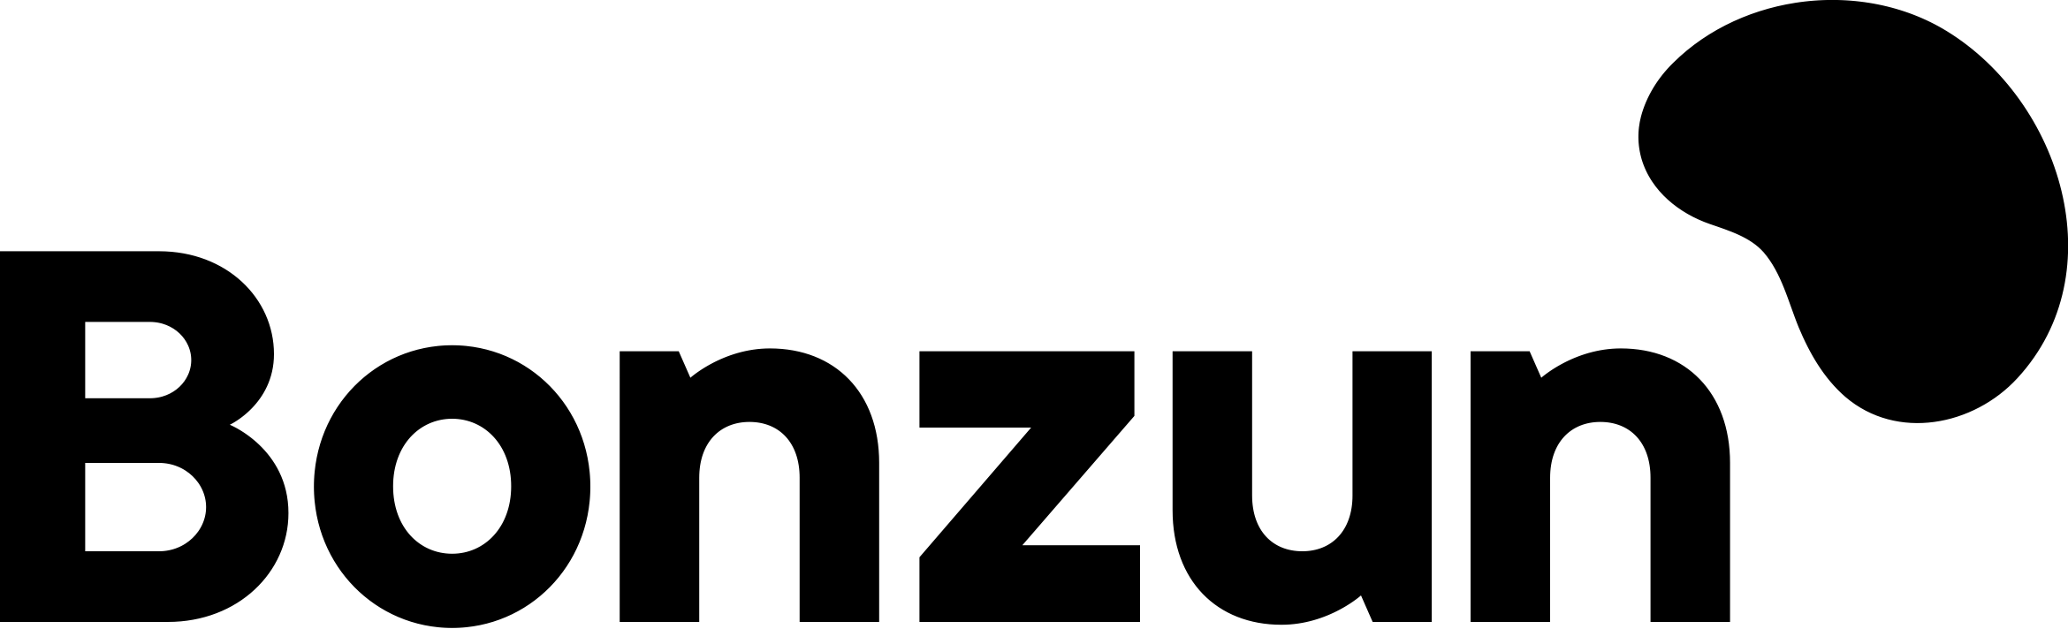
















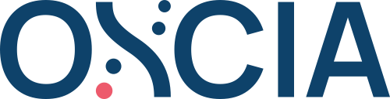

















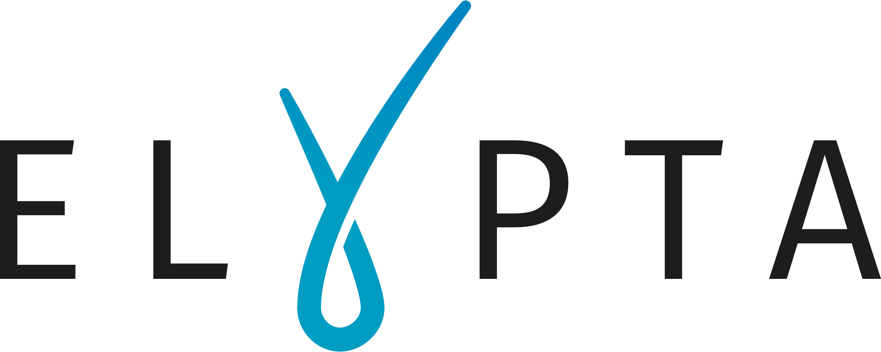
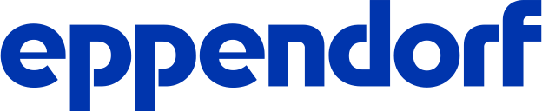





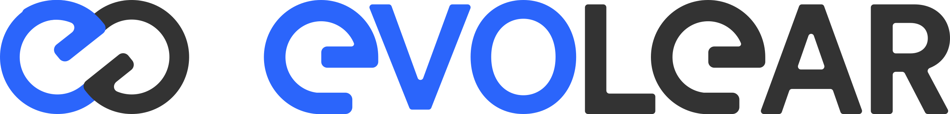
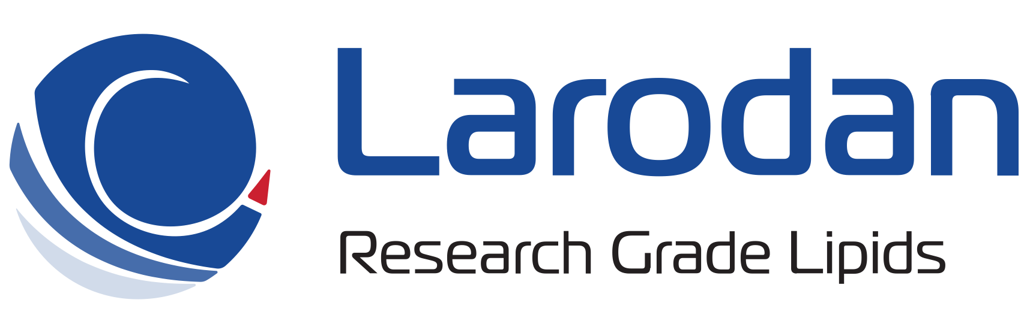




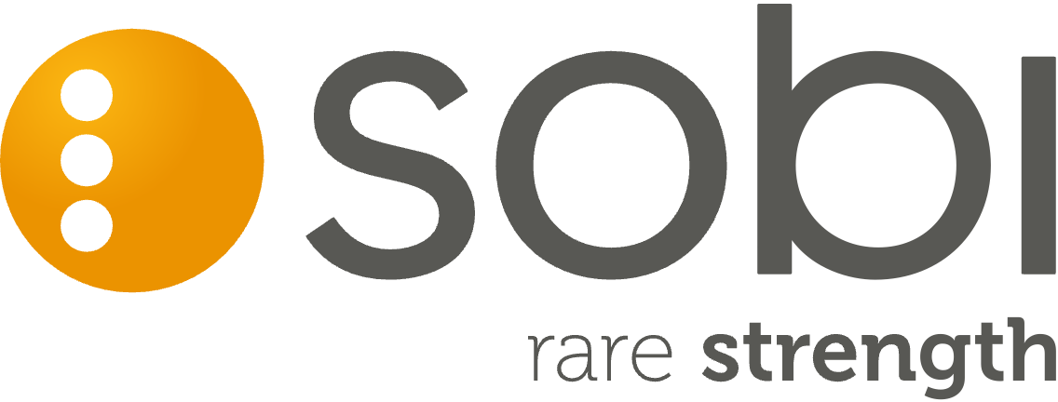
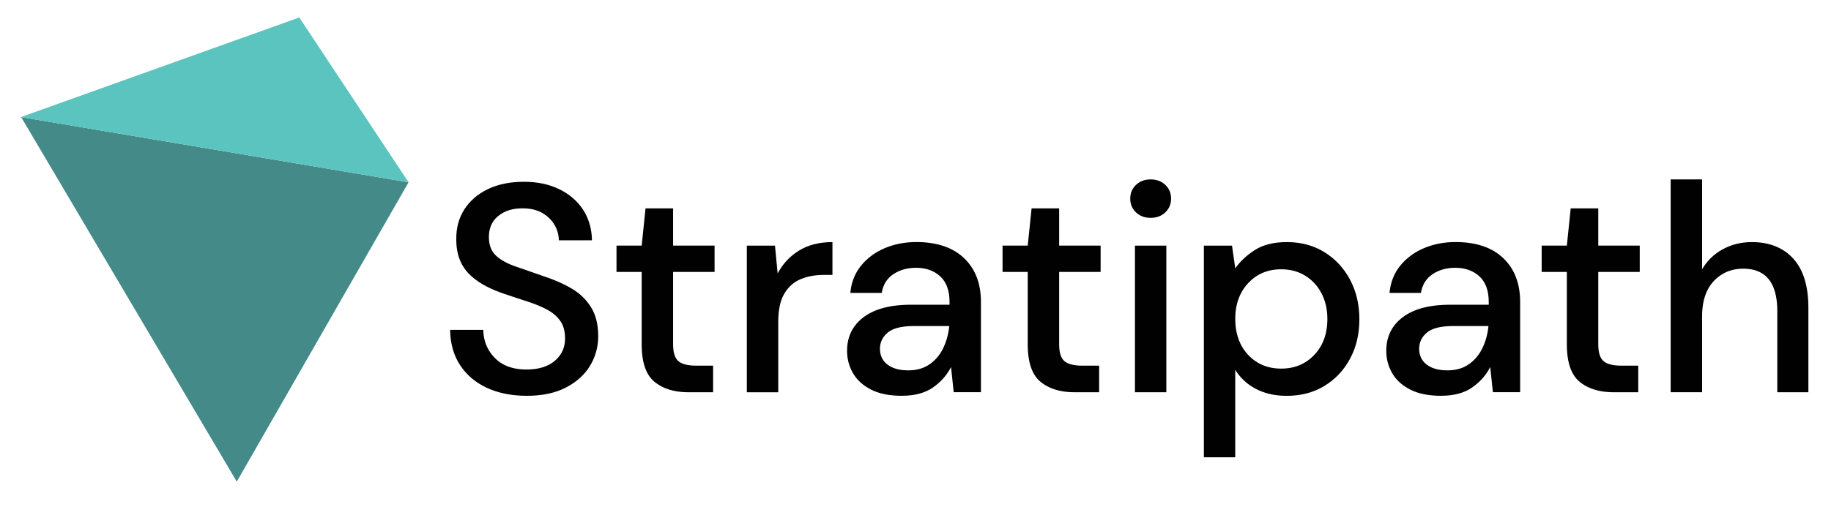







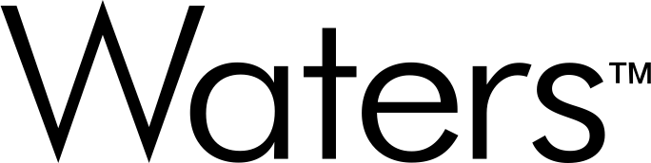

Life science in Hagastaden 2024
Forskaren
Wenner-Gren Center
← Solna city
Stockholm city →
S:t Eriks
Ögonsjukhus
Norra Tornen
Forskaren
Life City
Karolinska
Universitets-sjukhuset
Life City
Campus Solna
Bioclinicum
Campus Solna
175
Without logotype
Aula Medica
Mednessity AB
Noncomplicity AB
Nordic Range AB
ON Your Side AB
UC Research AB
Tandteknikerna i Solna AB
Wahtsui Biotech AB
We connect care Sweden AB
Xolve AB
Zelibra AB
Fysiologen
Bioseeker Group AB
Cfe Innovation And Consulting AB
Clinproducts for health AB
Cmm Innovation AB
Curara AB
Etvax AB
Farmett Läkemedel Aktiebolag
Gyllenevingar AB
Health Amplify AB
Lauma Labs AB
Mental Health In Mind International AB
Biotarget Engagement Interest Group AB
Precision Medicine Health Performance Longevity AB
Biomedicum
← SciLifeLab
Innomedicum
life science companies
Notes:
Hur ser det ut idag? 3 sep 2024
Cytiva, Astra
Ungefär lika många, men inte samma
Varav 16 dubbel

Slide 8
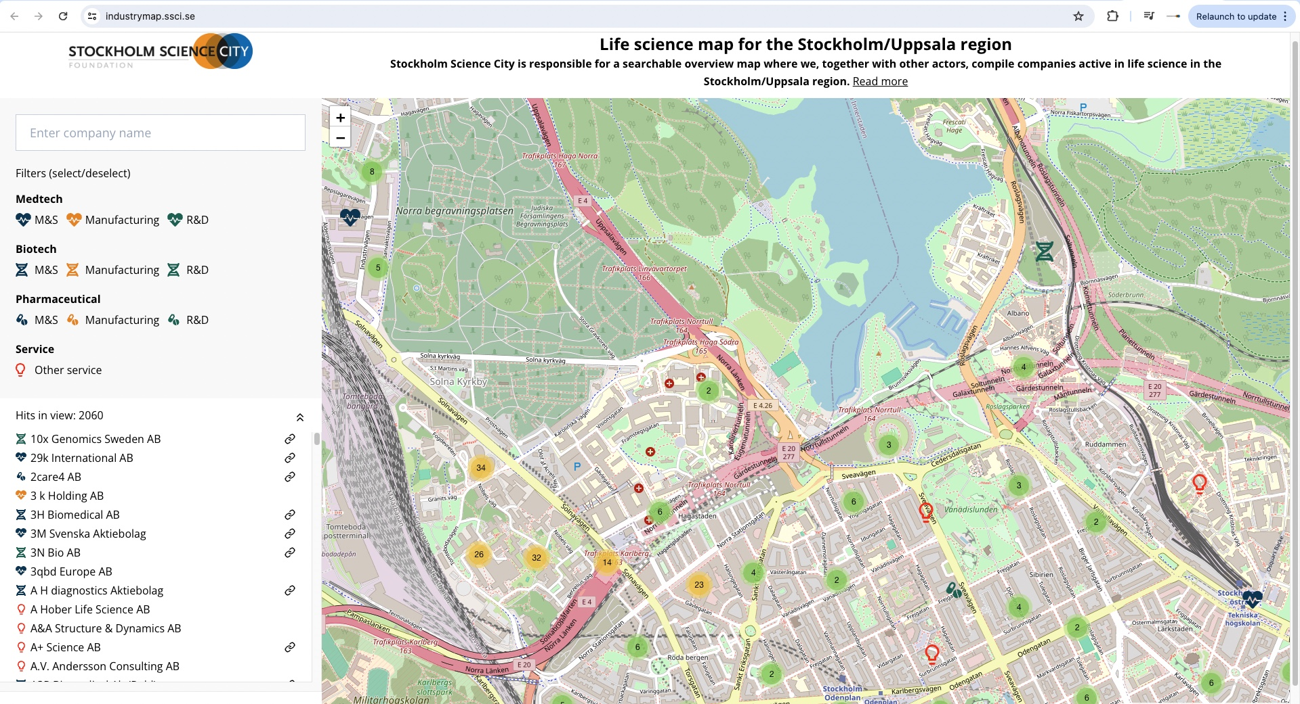
You will find all life science companies with a visiting address in Stockholm/Uppsala region presented on our website ssci.se

Slide 9
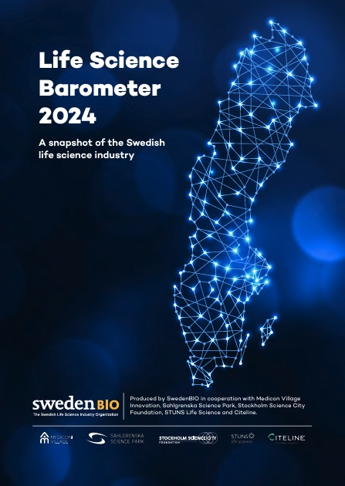

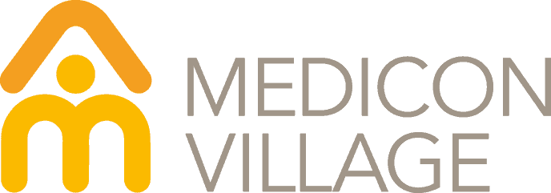



Life Science Barometer
2024
Answers from 200 business leaders, of which 89 in Stockholm

Slide 10
Life science-industrin
Short term outlook
Question: To what extent are each of the following a priority för your business at this time (2023/2024)?
The table shows the number of companies that responded “very much in focus” or “critical area of focus”
Source: SwedenBIO Life Science Barometer 2024.

Slide 11
Life science industry in Stockholm
Expected need for labs and offices
Shows number of companies.
A total of 89 companies responded
in the Stockholm region.
Source: SwedenBIO Life Science Barometer 2024.

Slide 12
Life science industry
Long term outlook
Source: SwedenBIO Life Science Barometer 2024.

Slide 13
Thanks!
Questions? info@ssci.se
Disclaimer: The regional data on page 3-6 in this presentation is sourced from Insight Machine, a database powered by STUNS. More details about sources, data compilation, and additional insights into the life science scene in Sweden can be explored there. Please be aware that this presentation specifically targets companies with registered offices in Stockholm County and Hagastaden. This compilation is crafted to the best of our ability, and any identified discrepancies are welcomed to be reported to us at info@ssci.se.

