Slide 1
Life science in Hagastaden
Updated: 2025-05-15
Questions? info@ssci.se

Slide 2
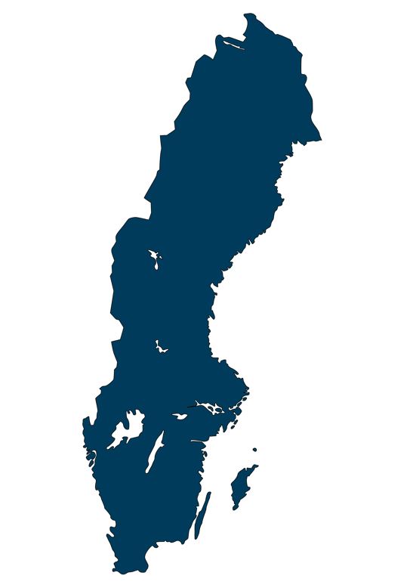
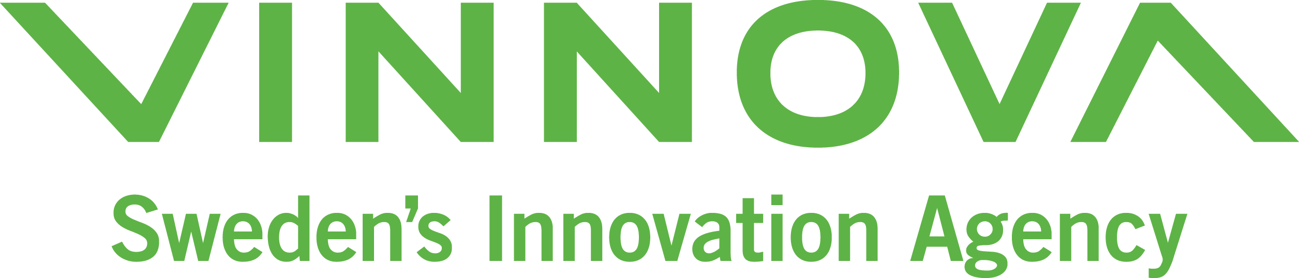
Life science in Sweden 2022
3838
A total of
6%
North
life science-companies in Sweden
Large companies, >250
(31)
Medium-sized companies, 50-249
(156)
Small companies, 10-49
(444)
Micro campanies, 1-9
(1257)
Companies without employees*
(1950)
Company size | Employees
Companies without employees | 0
Micro companies | 1-9
Small companies | 10-49
Medium-sized companies | 50-249
Large companies | >250
51%
East
18%
West
5%
South-East
20%
South
Source: Vinnova 2024, refer to 2022.
*Companies without employees can, for example, be newly established businesses where no one has been hired yet,
or where the owners invoice instead of taking a salary. This also includes companies for which information about the number of employees is missing.

Slide 3
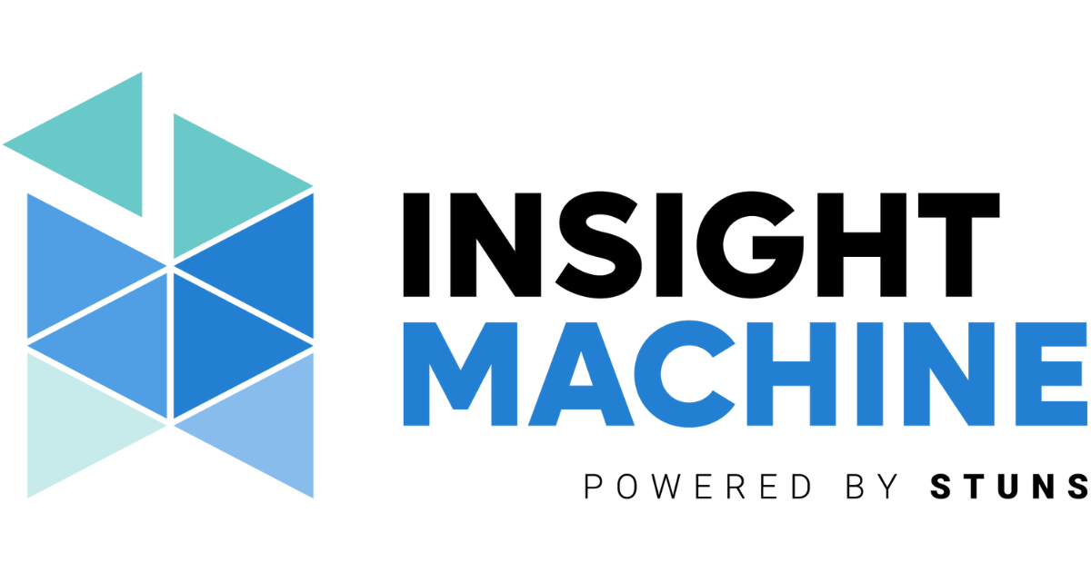
Life science in Stockholm/Uppsala 2023
2010
A total of
life science-companies in Stockholm/Uppsala,
of which 1473 had a turnover >0
Large companies, >250
(16)
Medium-sized companies, 50-249
(101)
Small companies, 10-49
(234)
Micro companies, 1-9
(756)
Companies without employees
(903)
45%
Source: STUNS Insight Machine, regional analysis by Stockholm Science City.
Refers to companies registered in Stockholm and Uppsala counties, 2023.

Slide 4
Life science in Hagastaden 2023
165
A total of
161 companies 2022
life science companies in Hagastaden,
of which 120 had a turnover greater than zero
Large companies, >250
(4)
Medium-sized companies, 50-249
(14)
Small companies, 10-49
(29)
Micro companies, 1-9
(63)
Companies without employees
(55)
38%
Source: STUNS Insight Machine, regional analysis by Stockholm Science City.
Refers to companies registered in Hagastaden, 2023.

Slide 5
Life science in Hagastaden 2023
Number of employees
2899
A total of
*
2188 employees 2022
Employees in life science companies in Hagastaden,
of which 2887 employed by companies with a turnover >0
Large companies>250
(793)
Medium-sized companies 50-249
(1169)
Small companies, 10-49
(732)
Micro companies, 1-9
(205)
Source: STUNS Insight Machine, regional analysis by Stockholm Science City.
Refers to companies registered in Hagastaden, 2023.
* Excluding SOBI. AstraZeneca has been manually added with 250 employees in Hagastaden.

Slide 6
Life science in Hagastaden 2023
Revenue
24bn
A total of
11,5 bn 2022
Revenue of life science companies in Hagastaden
Large companies >250
Medium-sized companies 50-249
Small companies, 10-49
Micro companies, 1-9
Companies without employees
Source: STUNS Insight Machine, regional analysis by Stockholm Science City.
Refers to companies registered in Hagastaden, 2023
* Excluding SOBI and Astra Zeneca

Slide 7


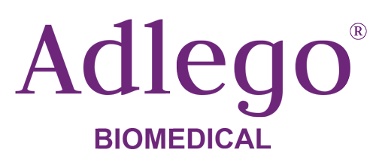



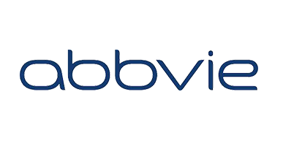




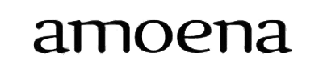







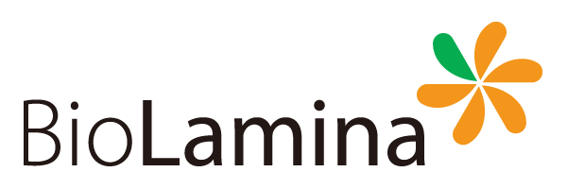


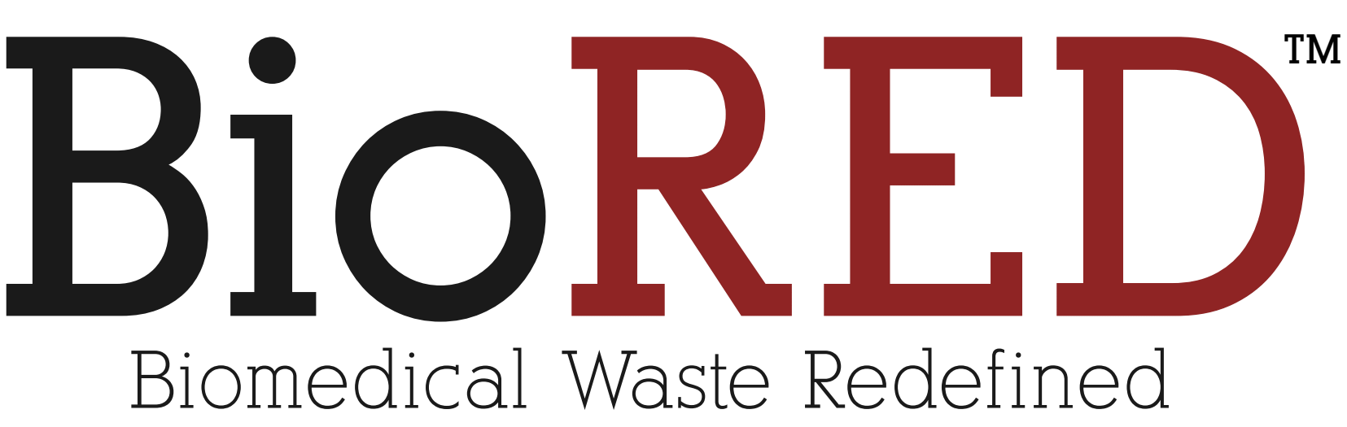



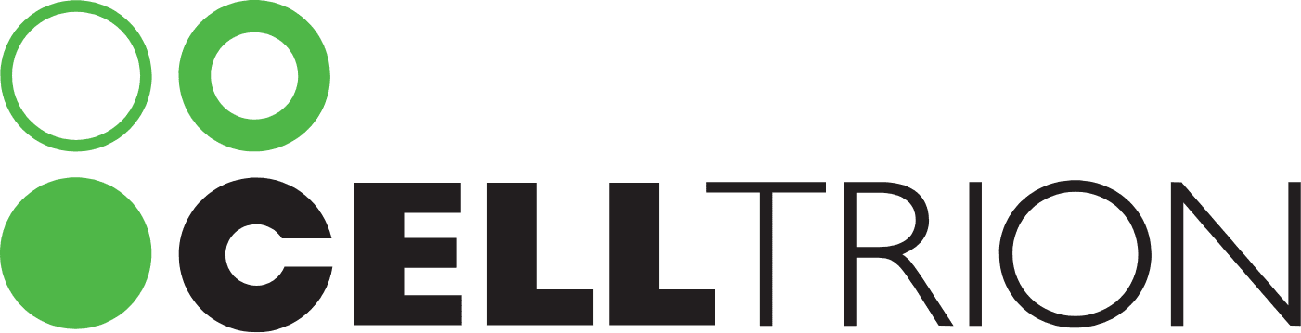

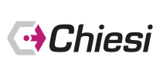


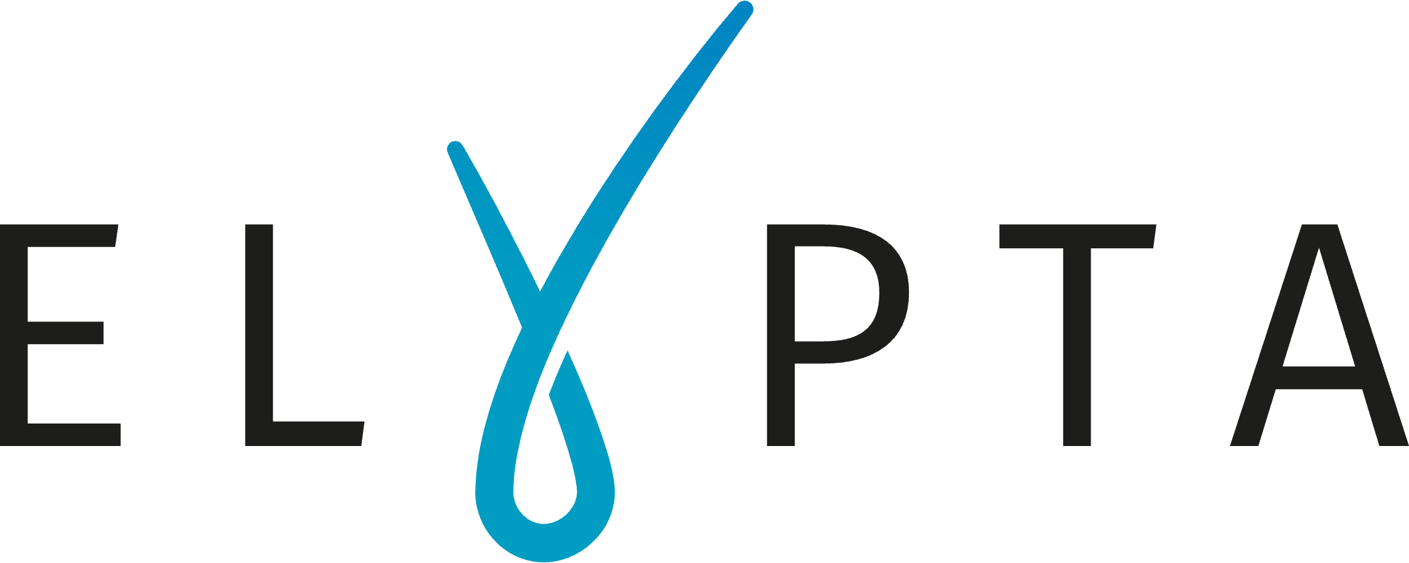



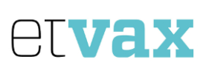
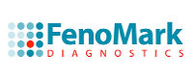

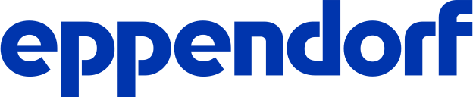













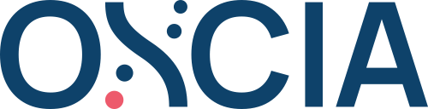









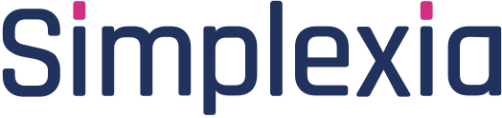
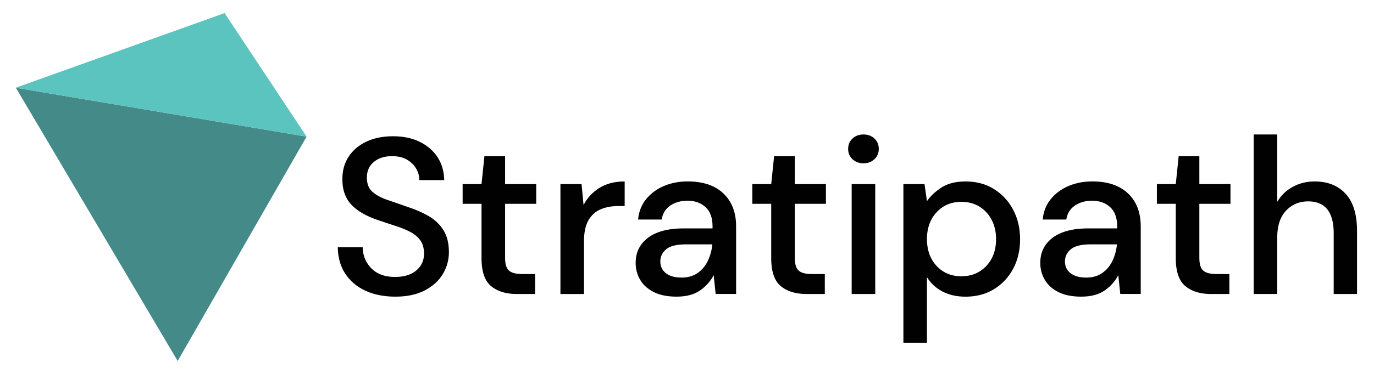

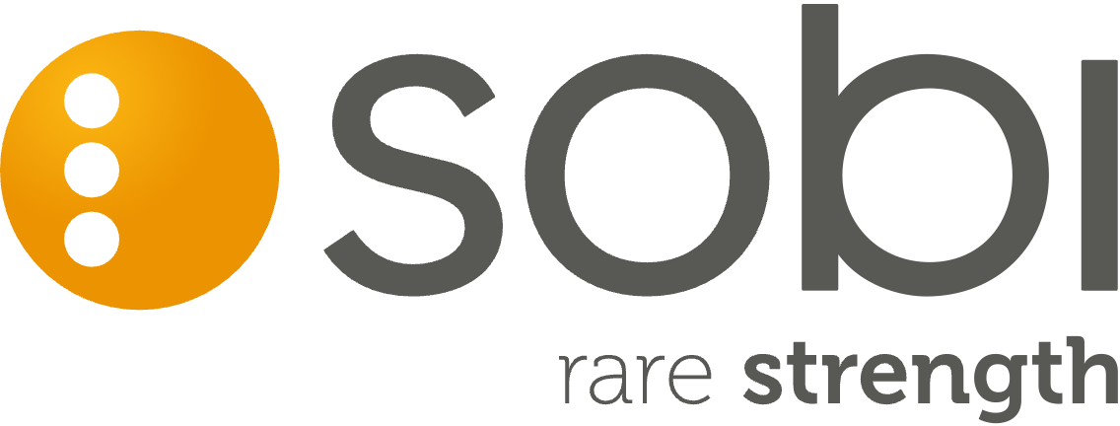






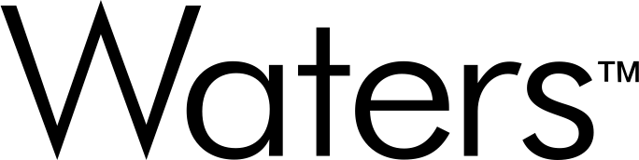



Life science in Hagastaden 2025
Biotarget
Engagement
Interest Group AB
Cfe Innovation
and Consulting
AB
Cmm
Innovation AB
Bioseeker
Group AB
Carme AB
Stockholm city →
Cremed AB
Curara AB
Cubase Bio
AB
Farmett
Läkemedel
Aktiebolag
Health Amplify
AB
185
KEBRIS AB
LDS
Consulting AB
LivMed
Stockholm AB
Mathias
Cardner AB
Mednessity AB
life science-companies
Medigelium
AB
Mental Health
In Mind
International AB
Microbalance
Sweden AB
MSH
Innovations AB
Nordic Range
AB
Olive &
Crown AB
Ortopedic care
Scandinavia AB
Precision Medicine
Health Performance
Longevity AB
Regenmed
Solutions AB
Semair
Diagnostics AB
SW Hydro
Invest AB
Translational
Medicine
International AB
Treström
Consultancy AB
Ullmed AB
Wahtsui
Biotech AB
We connect
care Sweden AB
Women's Heart
Health
Stockholm AB
Xolve AB
Zelibra AB
Note! The image shows 174 logos and company names. There are a total of 185 companies in Hagastaden. In some cases, multiple limited companies
share the same logo, which explains the difference in numbers. The image includes both life science companies registered in Hagastaden and companies
that have offices in the area, even if their headquarters are located elsewhere.

Slide 8
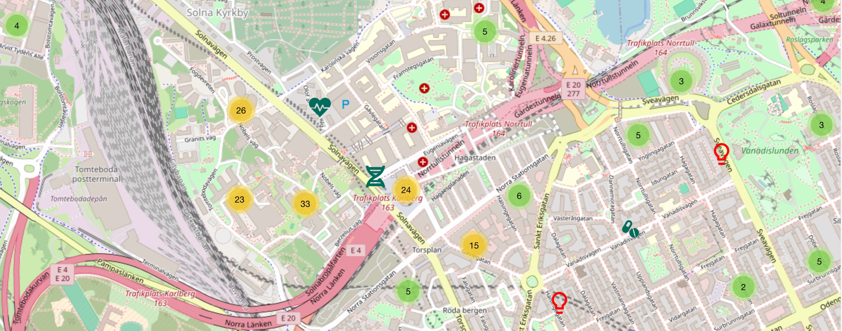
All life science companies with a visiting address in Stockholm/Uppsala are listed at ssci.se
Link to map

Slide 9
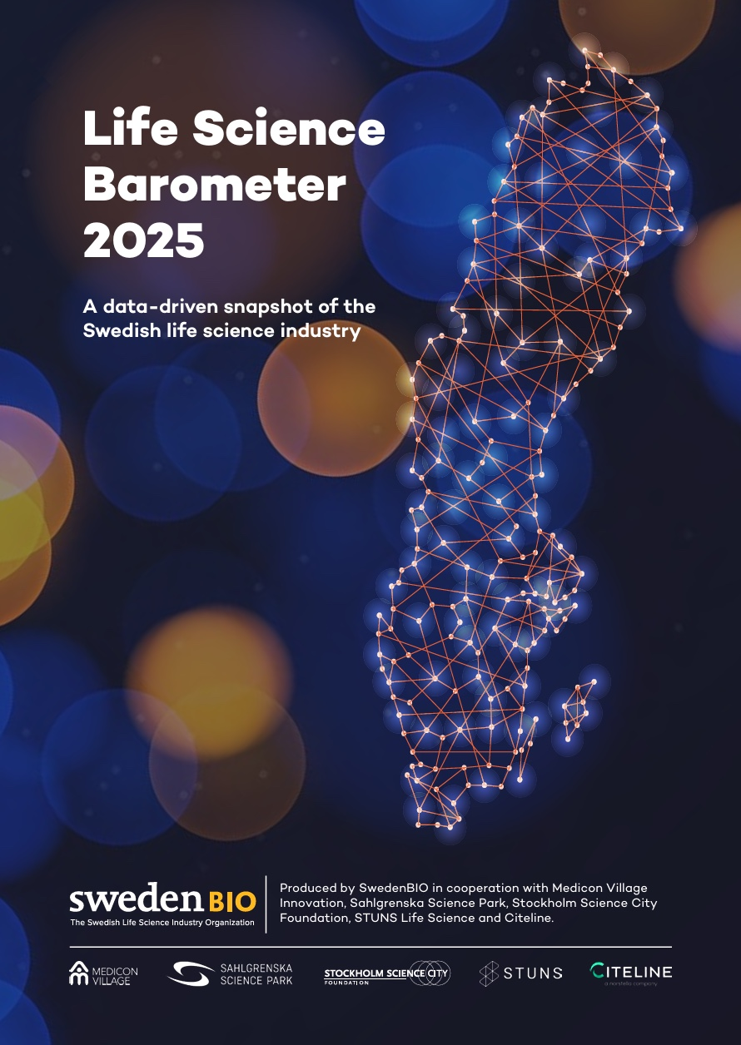

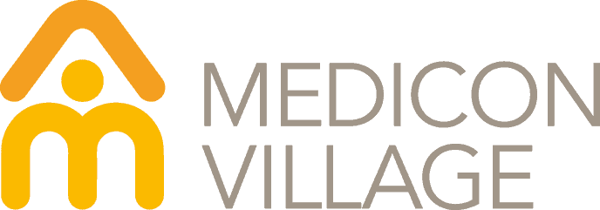

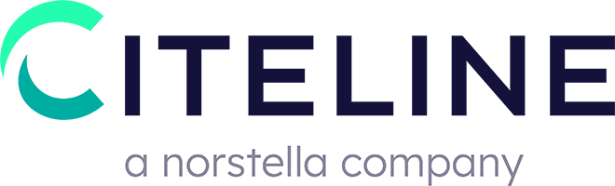


Life Science Barometer
2025
Responses from 207 business leaders, of whom 125 are based in Stockholm/Uppsala

Slide 10
Life science in Stockholm/Uppsala
Expansion Plans for 2025
54%
of companies (68)
plan to hire
additional staff
27%
of companies (34)
plan to hire
more consultants
23%
of companies (29)
plan to increase
their office space
12%
of companies (15)
plan to increase
their laboratory space
Read the full report
Source: SwedenBIO Life Science Barometer 2025.

Slide 11
Thank you!
Questions? info@ssci.se
Disclaimer: The national data in this presentation is sourced from Vinnova. The full Vinnova report can be found here. The regional data in this report comes from Insight Machine, a database operated by STUNS. More information about sources, data collection, and additional insights on life science companies in Sweden is available there. The compilation has been done to the best of our ability, and any inaccuracies or discrepancies are gratefully received via info@ssci.se.

