Slide 1
Taking the pulse of Hagastaden
April 2026

Slide 2
3879
life science companies in Sweden 2023
Source: Vinnova (2025), refers to 2023

Slide 3
2,1%
life science sector's contribution to Sweden's GDP 2023
Source: Vinnova (2025), refers to 2023

Slide 4
9,4%
of Sweden's exports consist of life science
Source: Vinnova (2025), refers to 2023

Slide 5
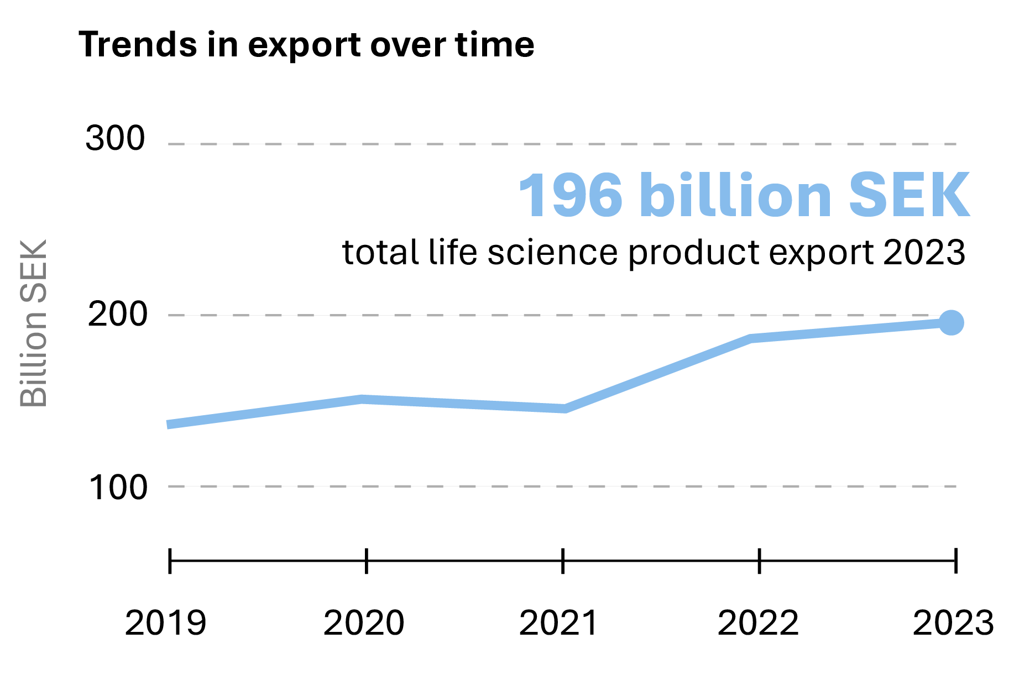
Life science – Sweden’s second-largest goods export category.
#capitaloflife
Source: SwedenBIO, 2026
Notes:
Life science is Sweden’s second largest goods export category*, with the Stockholm–Uppsala region accounting for nearly two-thirds of the production (SCB, Vinnova, 2023).
*Transport equipment is the largest goods export category in Sweden.
5

Slide 6
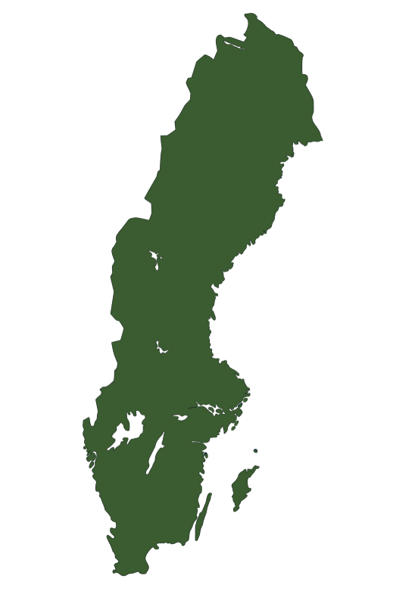
#capitaloflife
54%
of life science employees in Sweden are located in Stockholm/Uppsala
Stockholm/ Uppsala –
Capital of life:
Home to half of Sweden’s life science industry
48%
of Sweden’s life science companies are located in the Stockholm–Uppsala region
Source: Vinnova (2025), refers to 2023
Notes:
48% refers to Stockholm County and Uppsala County. Including Södermanland, Västmanland, and Örebro counties, what is commonly referred to as “Eastern Sweden”, the share of companies amounts to 51% (Vinnova).

Slide 7
Hagastaden
An innovation district in Stockholm
focused on life science.

Slide 8
239
life science companies in Hagastaden 2026
Source: Statistics Sweden (SCB), analysis by Stockholm Science City. Refers to life science companies (limited liability companies) registered in Hagastaden, as well as companies with offices/workplaces in the area, even if their headquarters are located elsewhere, 2026.

Slide 9
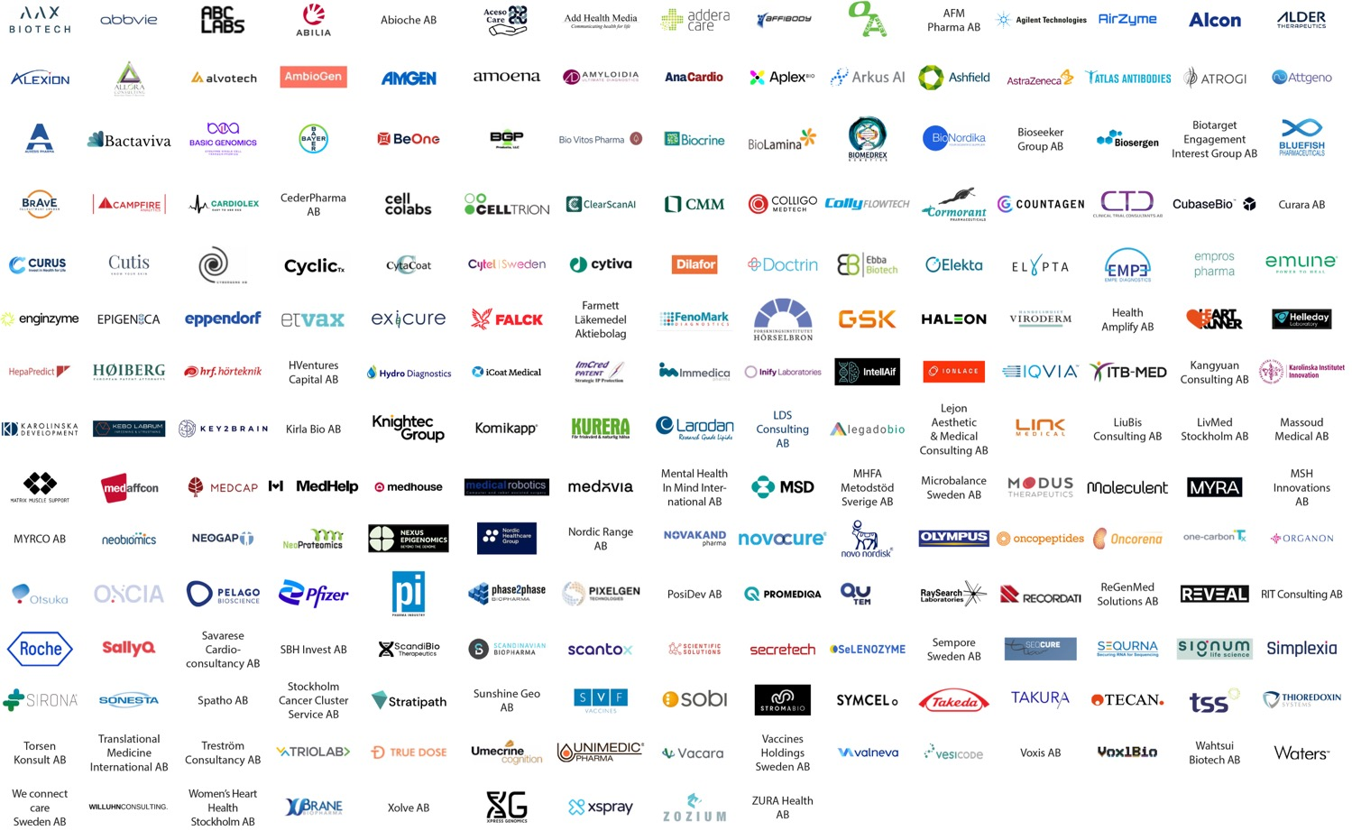
239
life science companies
in Hagastaden 2026
Note: 220 logos and company names are shown here, but there are a total of 239 life science companies in Hagastaden. In some cases, multiple limited companies share the same logo, which explains the difference in numbers. Both life science companies registered in Hagastaden and those with offices in the area are included, even if their headquarters are located elsewhere.

Slide 10
300%
increase in life science companies in Hagastaden since 2010
Source: Statistics Sweden (SCB), analysis by Stockholm Science City. Refers to life science companies (limited liability companies) registered in Hagastaden, as well as companies with offices/workplaces in the area, even if their headquarters are located elsewhere, 2026.

Slide 11
Life science enterprises in Hagastadens 2026
Source: Statistics Sweden (SCB), analysis by Stockholm Science City. Refers to life science companies (limited liability companies) registered in Hagastaden, as well as companies with offices/workplaces in the area, even if their headquarters are located elsewhere, 2026.
Notes:
De stora bolagen är Astra Zeneca, RaySearch Laboratories & Elekta Instrument.
Others är stödjande företag till life science, t.ex. konsulter.

Slide 12
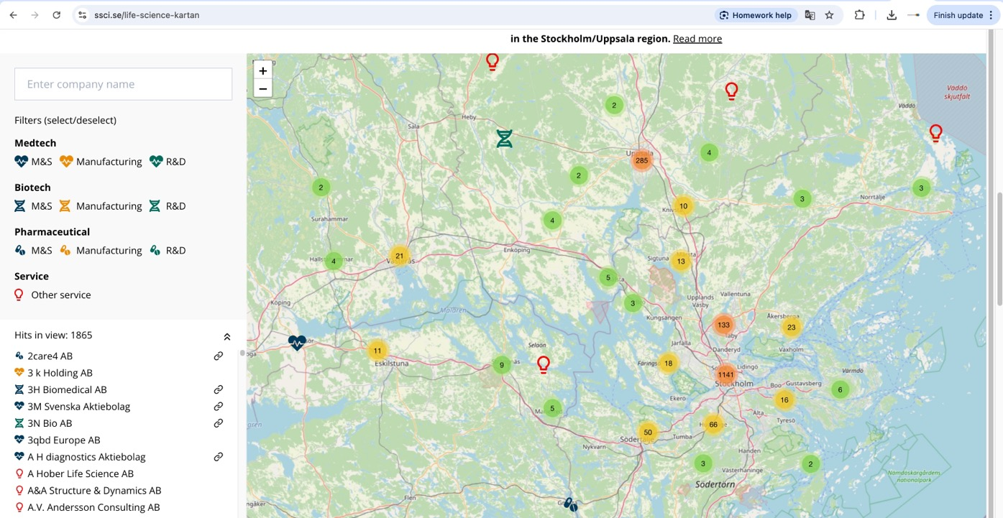
All life science companies in Stockholm/ Uppsala are available at ssci.se
Notes:
https://ssci.se/life-science-kartan

Slide 13
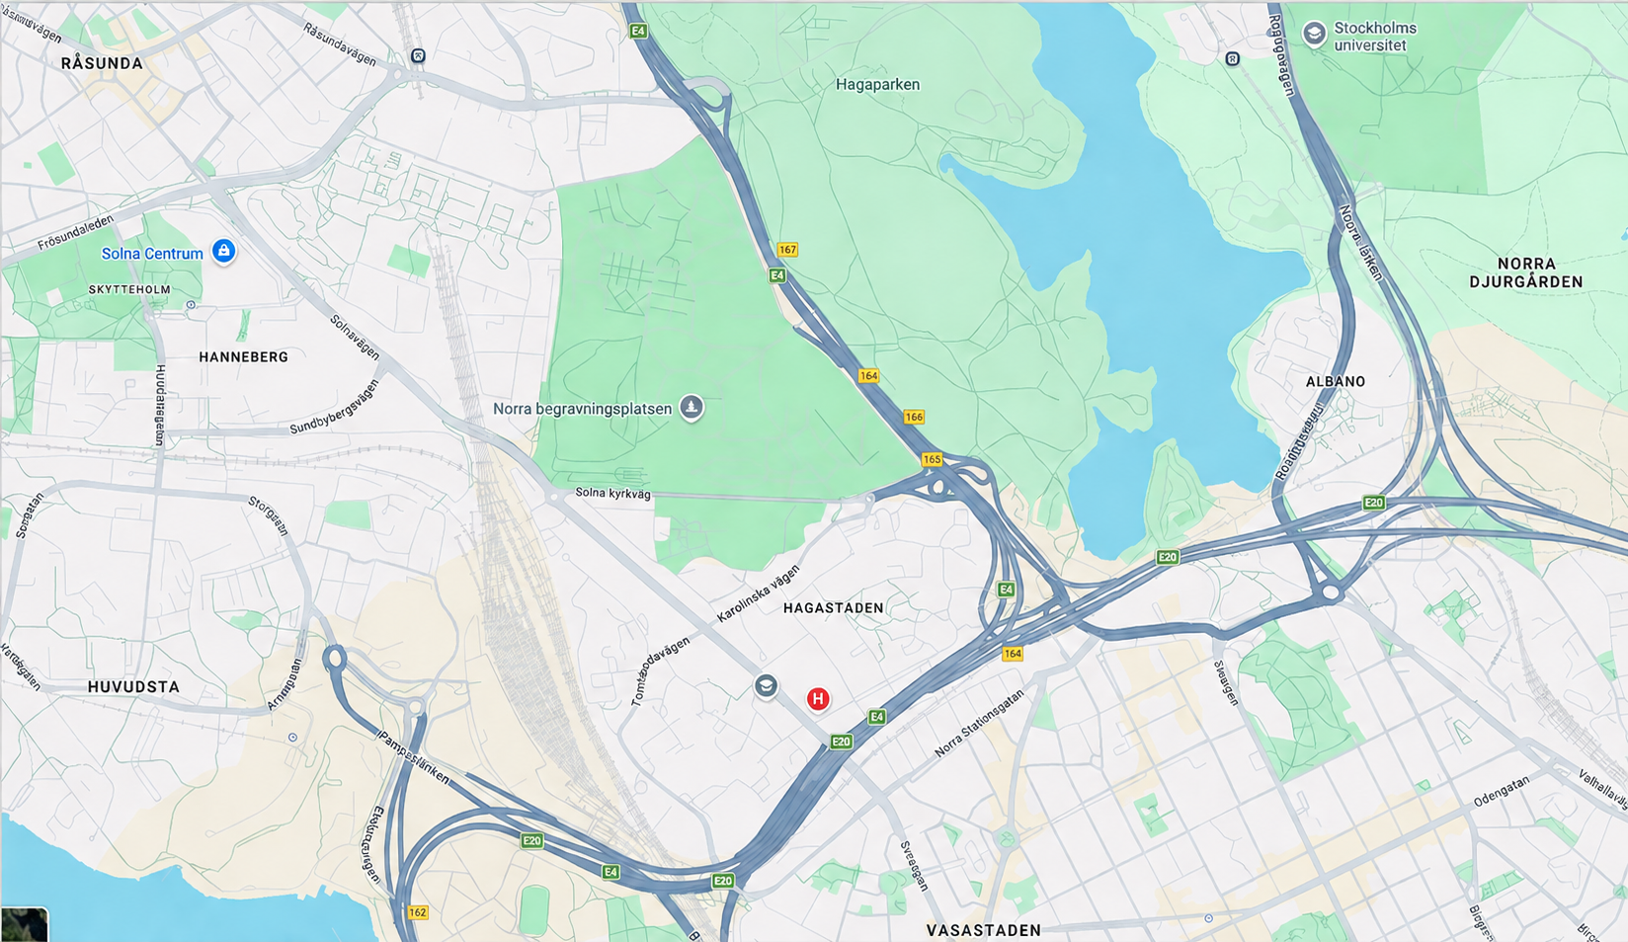
Notes:
The dark orange area shows the core of Hagastaden, but we can see the area expanding. To the east towards Sveaplan, south down to Vanadisgatan, and north up towards Hagalund. To the northwest, we include the Ingenting area, where companies such as Roche and Valneva are located.

Slide 14
3800
of Sweden’s workplaces are located in Hagastaden in 2026
Source: Statistics Sweden (SCB), analysis by Stockholm Science City. Refers to limited liability companies registered in Hagastaden, as well as companies with offices/workplaces in the area, even if their headquarters are located elsewhere, 2026.

Slide 15
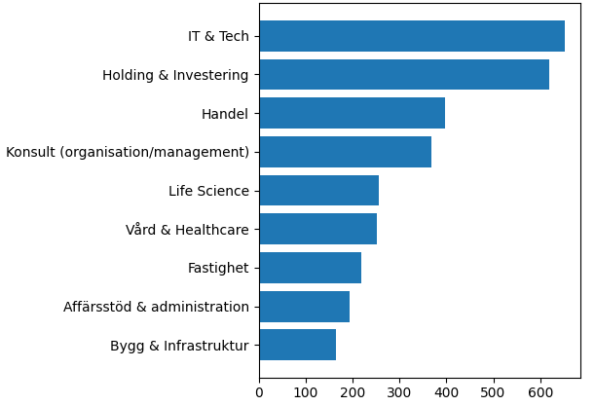
Hagastaden – Main industry sectors.
Hagastaden’s workplaces:
Main industry sectors.
IT & Tech
Holding & investering
Trade
Consultants (organisation/management)
Category
Life Science
Health & healthcare
Real estate
Business support & administration
Construction & infrastructure
Number of companies
Source: Statistics Sweden (SCB), analysis by Stockholm Science City. Refers to limited liability companies registered in Hagastaden, as well as companies with offices/workplaces in the area, even if their headquarters are located elsewhere, 2026.

Slide 16
6542
people live in Hagastaden 2026
Source: SCB & Juni Strategi
Notes:
Just under half of the residential units have been built as of 2026. The figure refers to the core/central part of Hagastaden.

Slide 17
44%
of residents in Hagastaden 2026 are aged 30–49.
Source: SCB & Juni Strategi
Notes:
Just under half of the residential units have been built as of 2026. The figure refers to the core/central part of Hagastaden.

Slide 18
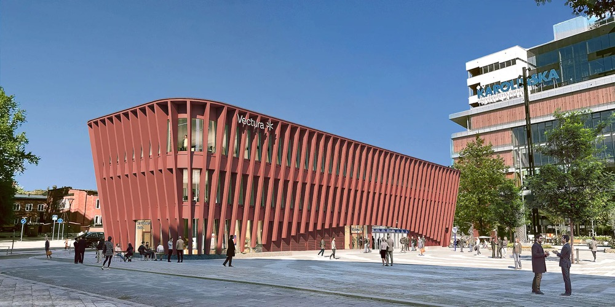
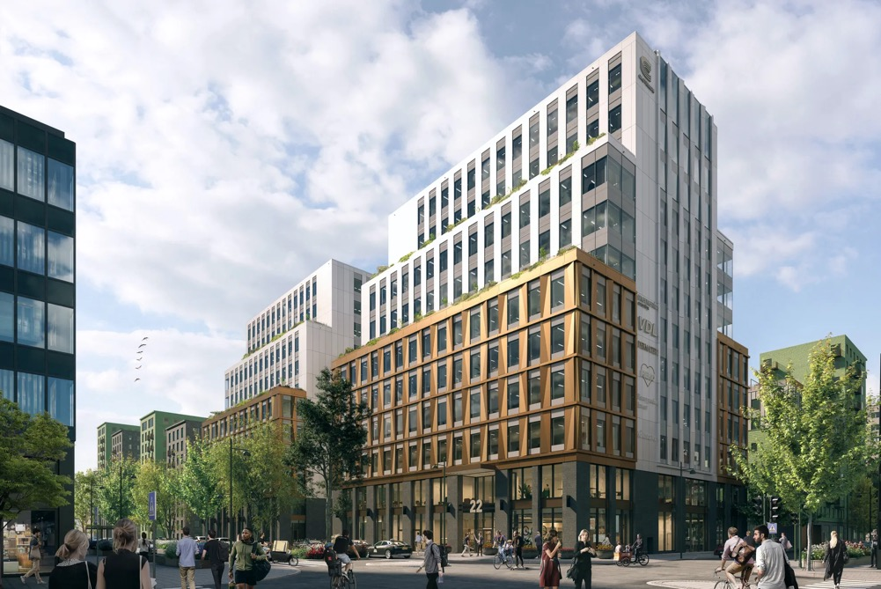
Central Hagastaden
Under construction:
- Pavia, Hagaplan (Vectura)
Metro entrance, Joe & the Juice and offices
- Infinity, Norra stationsparken (Castellum)
Ericsson has an option
Notes:
Buildings currently under construction, April 2026

Slide 19
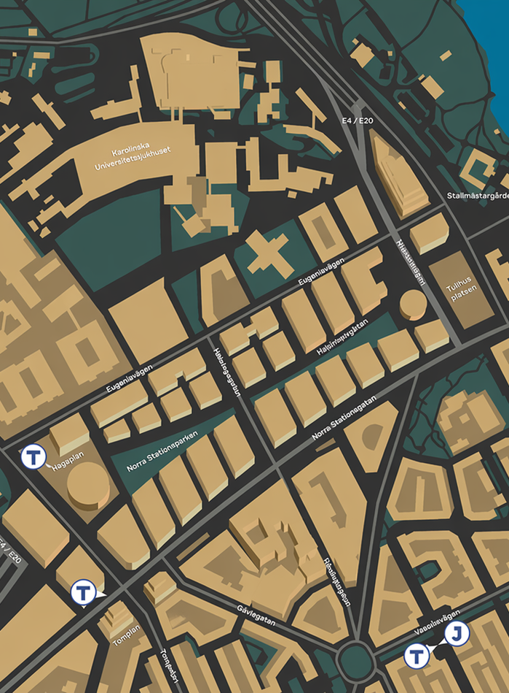
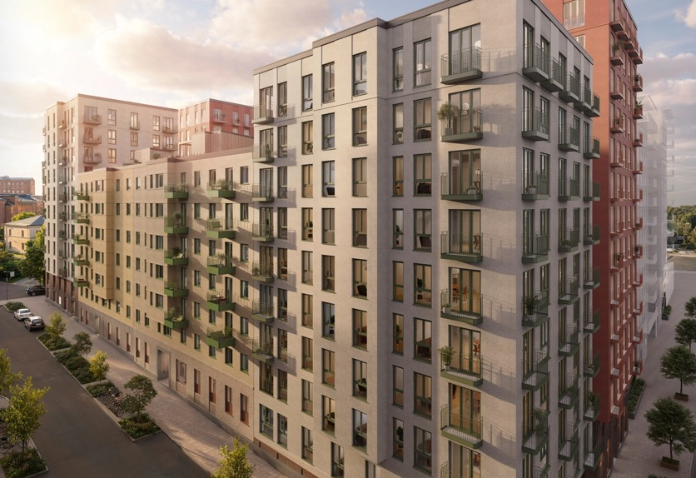
Block 27,
Stanford
Haga Heights
Housing (Besqab)
Central Hagastaden
Visionsbild: Besqab
Notes:
Upcoming buildings. The blue markings show Forskaren, Pavia, and Infinity.

Slide 20
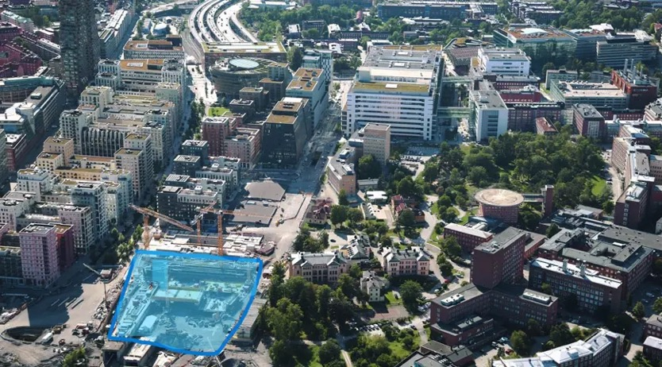
Block 26,
Cambridge
Corner of Höjer
Housing (Atrium Ljungberg)
Central Hagastaden
Notes:
Upcoming buildings. The name of the block comes from the street names in Hagastaden, which are named after prominent women in research and culture. Gerda Höjer was a distinguished nurse, politician, and Member of Parliament for the Stockholm City constituency in the Second Chamber.

Slide 21
Block 25,
Pisa
Corner of Ekeblad
Office (Atrium Ljungberg)
Central Hagastaden
Notes:
Upcoming buildings. The name of the block comes from the street names in Hagastaden, which are named after prominent women in research and culture. Eva Ekeblad was a Swedish countess and scientist. In 1748, she became the first woman elected to the Royal Swedish Academy of Sciences.

Slide 22
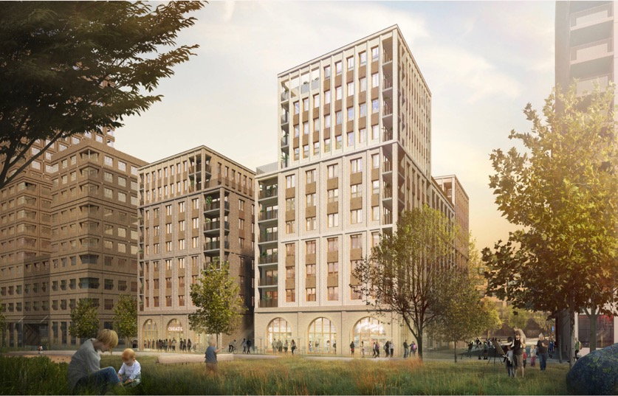
Block 10
Ribosomen
Office and housing (Humlegården)
Central Hagastaden
Vision image: Humlegården/Kjellander Sjöberg
Notes:
Upcoming buildings.

Slide 23
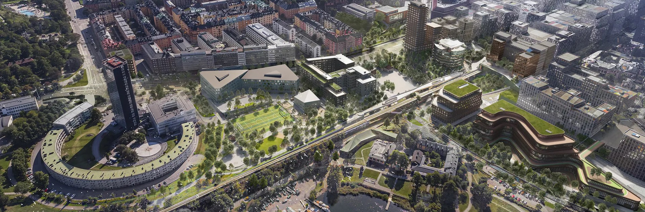
Eastern Hagastaden
Vision
Eastern Hagastaden
Image: Stockholms stad/White arkitekter

Slide 24
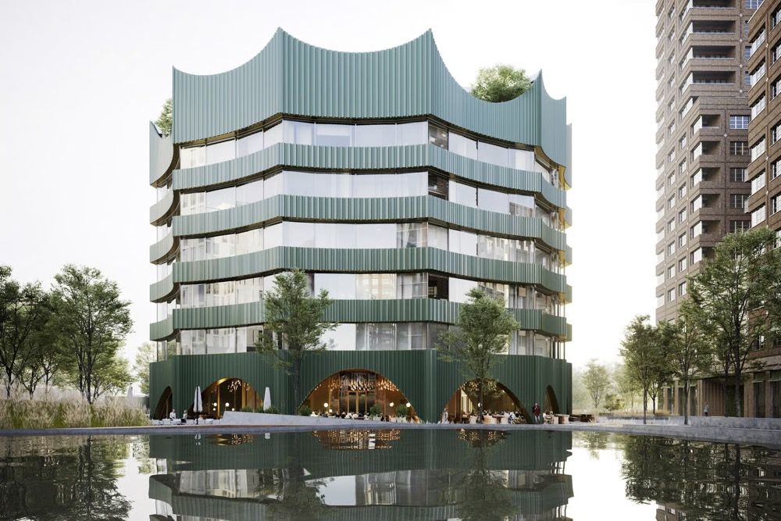
Block 11, Lipiden
Emerald House
Office (Castellum)
Eastern Hagastaden
Vision image: Castellum
Bild: Stockholms stad/White arkitekter
Notes:
Upcoming buildings.

Slide 25
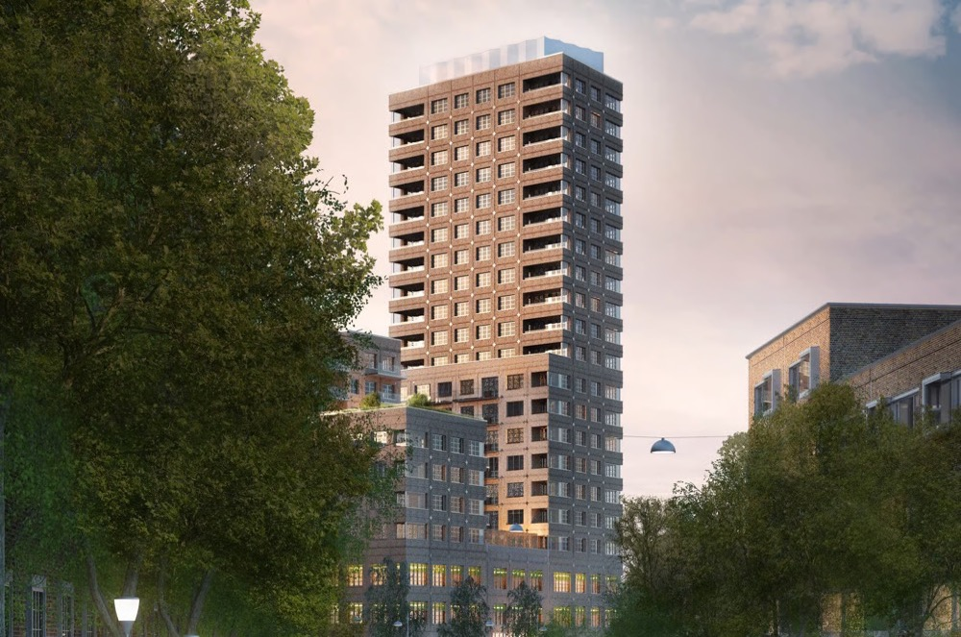
Block 12, Genomet
Jubileumshuset
Office & housing (Castellum & HSB)
Eastern Hagastaden
Vision image: Castellum/HSB
Notes:
Upcoming buildings.

Slide 26
Block 13
Stadstullen
Care and nursing home & student housing
Eastern Hagastaden
Image: Stockholms stad/White arkitekter
Notes:
Upcoming buildings.

Slide 27
Block 14
Sports & KOffice (Vectura, early land allocation)
Eastern Hagastaden
Photo: Stockholms stad/White arkitekter
Notes:
Upcoming buildings.

Slide 28
Block 15, Sapienza
Wave
Office (Atrium Ljungberg)
Eastern Hagastaden
Photo: Stockholms stad/White arkitekter
Notes:
Upcoming buildings.

Slide 29
Block 16, Trinity
Hotel → office
Eastern Hagastaden
Photo: Stockholms stad/White arkitekter
Notes:
Upcoming buildings.

Slide 30
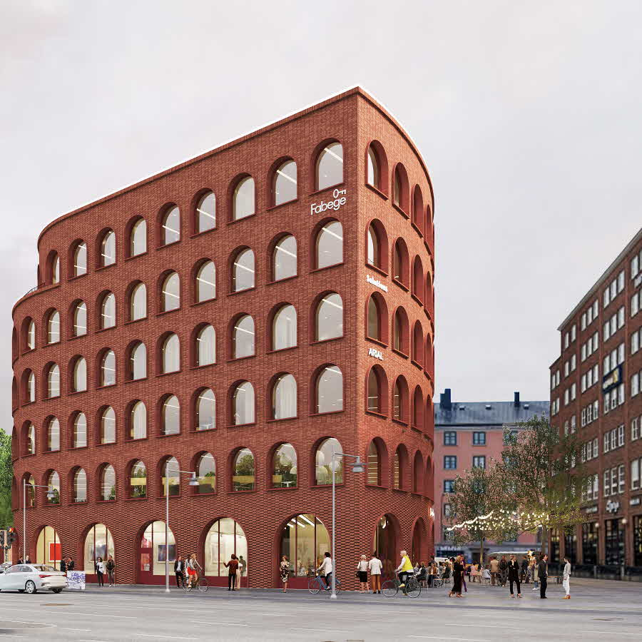
Kvarter 17, Gadden
Sveaplan
Office (Fabege)
Eastern Hagastaden
Photo: Stockholms stad/White arkitekter
Photo: Fabege
Notes:
Upcoming buildings.

Slide 31
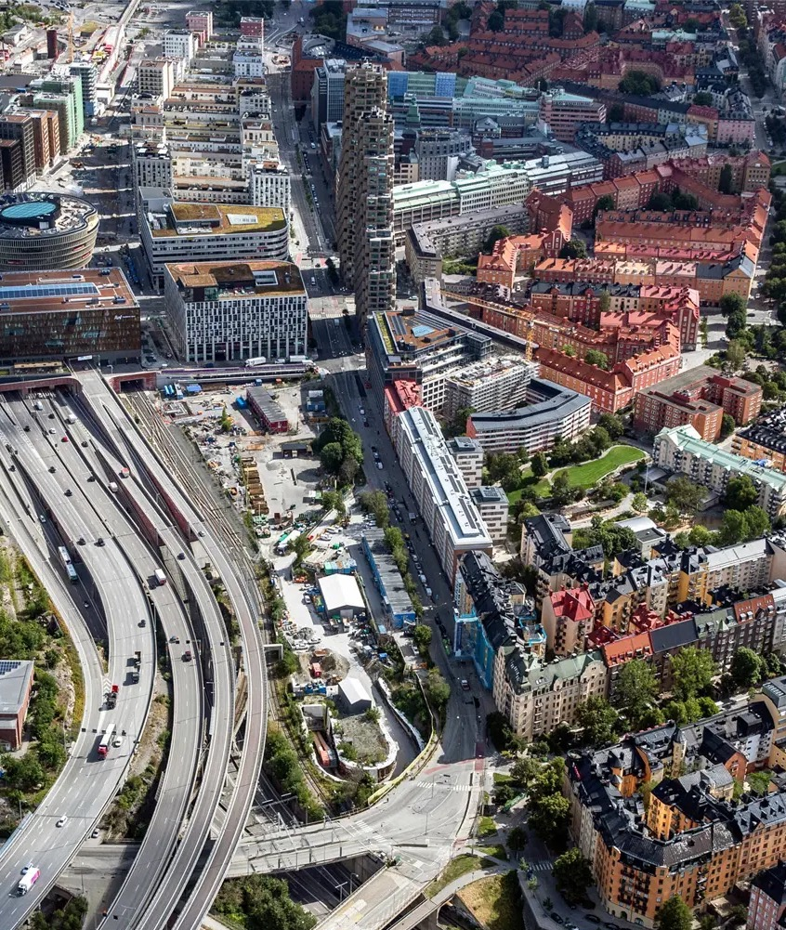
Western
Hagastaden
Current status
Photo: Stockholms stad
Notes:
Upcoming buildings.

Slide 32
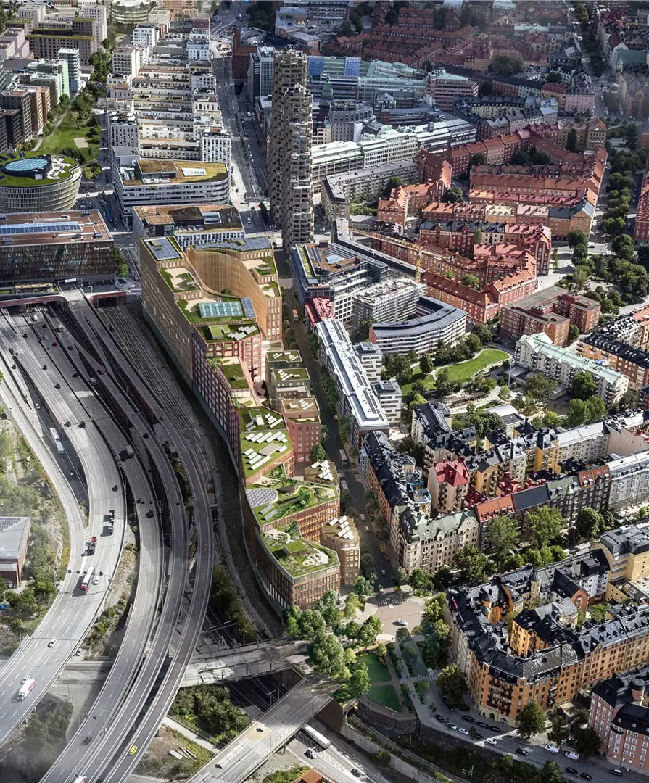
Western
Hagastaden
Vision
Photo: Stockholms stad/White arkitekter
Notes:
Upcoming buildings.

Slide 33
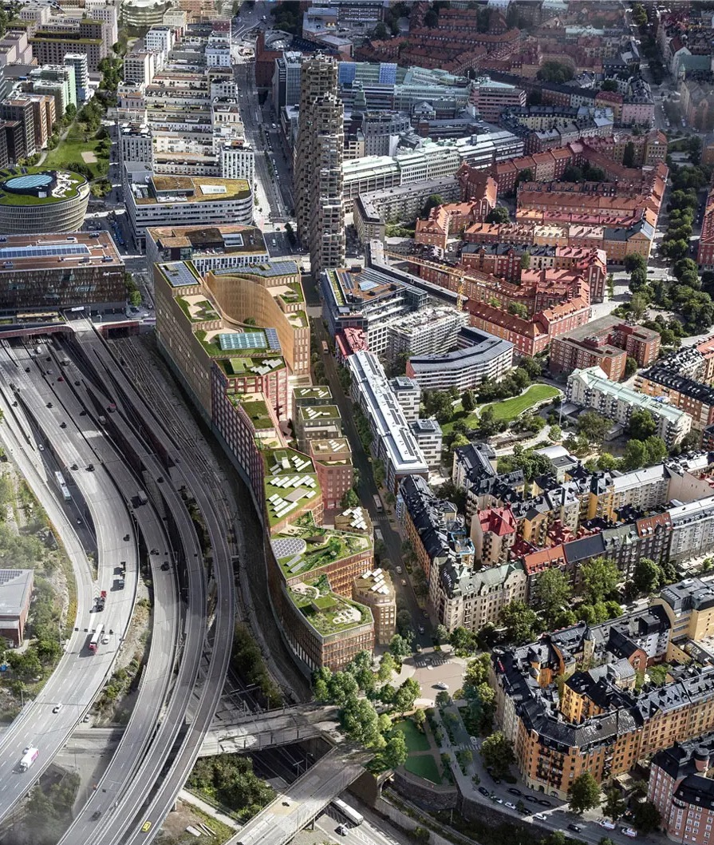
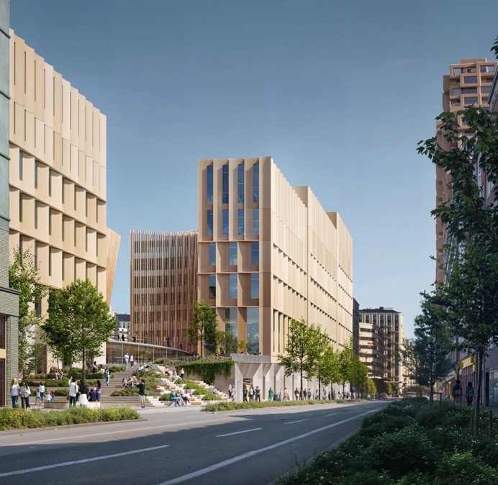
Block 37
Mellom
Sports, culture, office and lab
(Vectura)
Western Hagastaden
Vision image: Vectura/Snohetta
Photo: Stockholms stad/
White arkitekter
Notes:
Upcoming buildings. KFUM Central is responsible for the sports facilities.

Slide 34
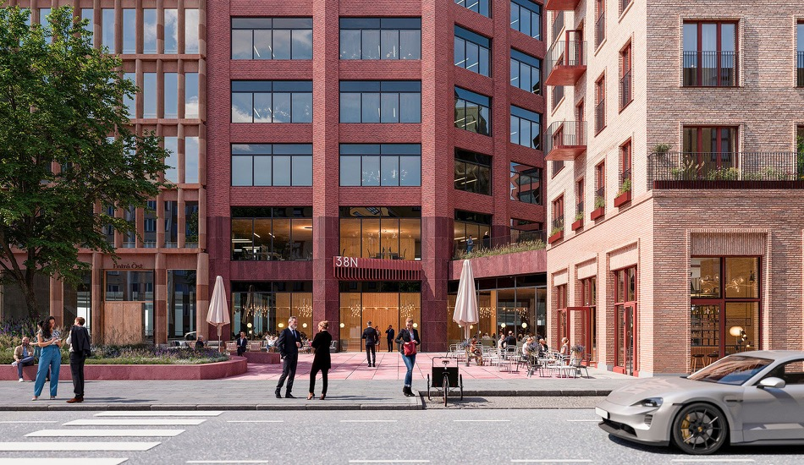
Block 38N
Bivium House
Office and talent/housing for researchers
(Humlegården)
Western Hagastaden
Bild: Stockholms stad/White arkitekter
Vision image: Humlegården
Notes:
Upcoming buildings.

Slide 35
Block 38S
Senior housing
(Seniorgården)
Western Hagastaden
Vision image: Stockholms stad/White arkitekter
Notes:
Upcoming buildings. KFUM Central is responsible for the sports facilities.

Slide 36
Block 39
Campus F
Office and housing
(Vectura)
Western Hagastaden
Vision image: Stockholms stad/White arkitekter
Notes:
Kommande byggnader

Slide 37
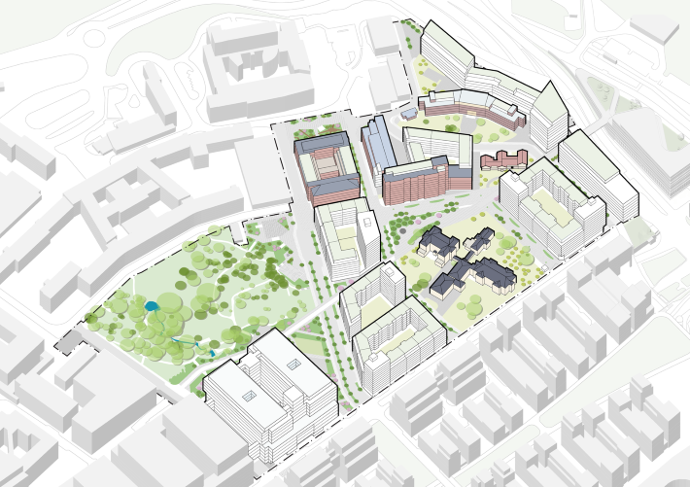
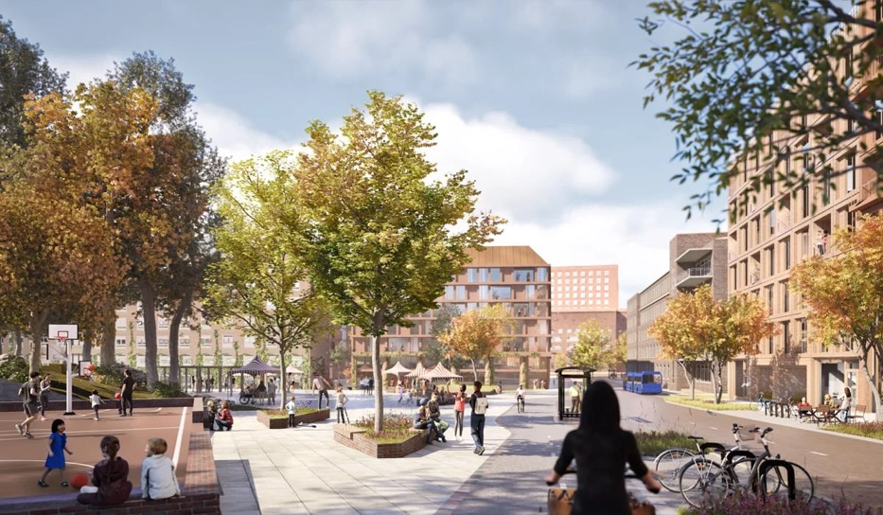
North
Hagastaden
- 3000 housing
- 150,000 sqm of commercial space
- Local plan 1 out for consultation over the summer
Region Stockholm
Vision image: Region Stockholm/White arkitekter

Slide 38
Thank you!
Questions? info@ssci.se

